Slide 1
Design Principles for Connected Devices
Chapter 2

Slide 2
2.1 Introduction
Letter…………………
Similarly, when data is transferred from a sensor, then functional units create a stack for data communication to an application.
IoT or M2M device data refers to the data meant for communication to an application, service or process. Data also refers to data received by a device for its monitoring or for actions at actuator in it.

Slide 3
Data stack denotes the data received after the actions at various in-between layers. Layers in OSI model are Application, Presentation, session, transport, Network, data-link and physical.

Slide 4
Following are the key terms which need to be understood to learn the design principles of connected devices for IoTs :
Layer refers to a stage during a set of actions which the action is taken as per a specific protocol or method..
Physical layer refers to a layer at transmitting-node or at the receiving node for the data bits. The transfer uses physical system and refers to wireless or wired transmission. This layer is the lowest layer.

Slide 5
Application layer refers to a layer for transmitting or receiving the data bits of an application. Data bits route across the network and transfer takes place as follows:
Application data from the application layer transfers after passing through several in-between layers to the physical layer, and from there it transmits to the receiving-end physical layer.
Then ,the data at the receiving node transfers from the physical layer to the application layer after passing through several in-between layers.

Slide 6
Level refers to a stage from the lowest to the highest. For example, acquiring device data and actions that may be considered at the lowest level and actions in business processes at the highest level.
Domain refers to a set of software , layers or levels having specific applications and capabilities. For example, CoRE network, access network, service capabilities and applications can be considered as one domain, say, network domain. A domain generally has limited interactions with other domains or outside the domain.

Slide 7
Gateway refers to software for connecting two application layers, one at the sender and the other at the receiver. A gateway may be of different types. A communication gateway at device and gateway domain has capabilities as protocol-conversion during communication between two ends when each end uses distinct protocols.
An internet gateway may have capabilities besides protocol conversion, transcoding data, device management and data-enrichment before the data communicate over the internet. Dictionary meaning of gateway is a place you go through because it leads to a much larger place.`

Slide 8
IP stands for Internet Protocol version 6(IPv6) or Internet Protocol version 4(IPv4) for the network layer(v6 means version 6, v4 version 4).
Header means a set of octets containing information about the data being sent. Header packs the data of a layer before transmission to the next layer during communication between two end-points.
The size of a header and its fields are according to the protocol used for creating data stack at a layer.
For example: IPv4 header has fields as per IP network layer…
The field helps in processing the packet when transferring it from one layer to the next one.

Slide 9
Packet means packaged data-stack which routes over the network.
Packet size limit is according to the protocol.
For example, IPv4 packet size limit is 2¹⁶ B

Slide 10
Protocol Data Unit is a unit of data which is specified in a protocol of a given layer which transfers from one layer to another.
PDU is transfers from physical layer; frame from data-link layer; packet from network layer; segment from transport layer and text from application and other layers.

Slide 11
Maximum Transmission Unit(MTU) is the largest size frame or packet or segment specified in octets that can be sent in a packet or frame-based network such as the Internet.
For example:
consider transfers of a segment from the transport layer using the Transmission Control Protocol(TCP) to the network layer.
The MTU determines the maximum size of each data stack in any transfer to the network layer.
The network layer determines the maximum sixe of each frame in any transfer to the data-link layer and then uses MTU of the data-link layer.

Slide 12
Star network denotes the number of nodes interacting with a coordinator or master node.
Mesh network denotes the number of nodes that may interconnect with each other.
End-point device or node denotes he one that provides connectivity to a coordinator or router.
Coordinator denotes the one that connects to a number of end-points as well as routers in a star topology and forwards the data stack from one attached end point/ router to another.

Slide 13
Master refers to the one who initiates the pairing with the devices in a star topology network.
Slave means one that pairs with a master, uses the clock signals from master for synchronisation and uses address assigned by the master at the beginning.
Router refers to a device or node capable of storing paths each destination to which it has logical links. The router sends the data stack according to the available path or paths at a receiving instance.

Slide 14
Application means software for specific tasks, such as streetlight monitoring or control.
Service means service software, for example, report generation or chart visualisation service.
Process means a software component which processes the input and generates the output;

Slide 15
2.2 IoT/M2M Systems, Layers And Designs Standardisation
A number of international organisations have taken action for IoT design standardisation. Examples are :
IETF(Internet Engineering Task Force), an international body initiated actions for addressing and working on the recommendations for the engineering specifications for the Internet of Things.
IETF suggests the specifications for the layers, and the engineering aspects for the IoT communication, networks and applications.

Slide 16
(ITU-T) International Telecommunication Unionfor Telecommunication suggested a reference model for IoT domain, network and transport capabilities for the IoT services and the applications at the application and application-support layers.
(ETSI) Europian Telecommunication Standards Institute initiated the development of set of standards for the network , and devices and gateway domains for the communication between machines.

Slide 17
(OGC) Open Geospatial Consortium, an International Industry Consortium, has also suggested open standards for sensors discovery, capabilities ,quality and other aspects with support to geographical information web support.

Slide 18
2.2.1 Modified OSI model for the IoT/M2M systems
The seven-layer OSI model is a standard model. It gives the basic outline for designing a communication network.
A classical seven-layer OSI model and the modifications in that model proposed by IETF.
Data communicates from device end to application end.
Each layer processes the received data and creates a new data stack which transfers it to the next layer.
The processing takes place at the in-between layers, i.e. between the bottom functional-layer to the top layer.
Device end also receives data from an application/service after processing at the in-between layers.
Gather+Enrich+Stream(manage+acquire+organise+analyse)=IoT applications and services

Slide 19
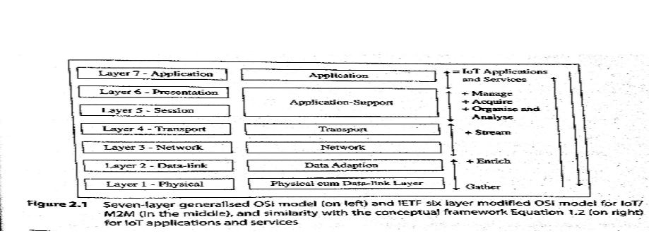

Slide 20
New applications and services are present at the application layer6.
A modification to this is that the application-support layer 5 uses protocols, such as CoAP
IoT applications and services commonly use them for network communication.
The CoAP protocol at the layer is used for request/response interactions between the client and server at the network.
Similarly, the application-support layer may include processes for data managing, acquiring, organising and analysing which are mostly used by applications and services.

Slide 21
Modifications are also at the data-link layer2and physical layer 1.
The new layers are data-adaption and physical cum data-link. The data-adaption layer includes a gateway. The gateway enables communication between the devices network and the web.
A physical IoT/M2M device hardware may integrate a wireless transceiver using a communication protocol as well as a data-link protocol for linking the data stacks of L1 and L2.

Slide 22
What are the architectural layers in a modified OSI model for Internet of smart streetlights application in example 1.2?
Consider a model for Internet of streetlights. Following are the layers for data interchange in the modified OSI model :
L1 : It consists of smart sensing and data-link circuits with each streetlight transferring the sensed data to L2.
L2: It consists of a group-controller which receives data of each group through Bluetooth or ZigBee, aggregates and compacts the data for communication to the Internet, and controls the group streetlights as per the program commands from a central station.
L3: It communicates a network stream on the Internet to the next layer.
L4: The transport layer does device identity management , identity registry and data routing to the next layer.
L5: The application-support layer does data managing, acquiring, organising and analysing, and functionalities of standard protocols such as CoAP, UDP and IP.
L6: The application layer enables remote programming and issue of central state directions to switch on-off and commands of services to the controllers along with monitoring each group of streetlights in the whole city.

Slide 23
2.2.2 ITU-T Reference Model
ITU-T reference model RM1 considers four layers which are :
Lowest Layer, L1 , is the device layer and has device and gateway capabilities.
Next layer, L2, has transport and network capabilities.
Next layer ,L3, is the services and application-support layer. The support layer has two types of capabilities- generic and specific service or application-support capabilities.
Top layer, L4, is for applications and services.

Slide 24
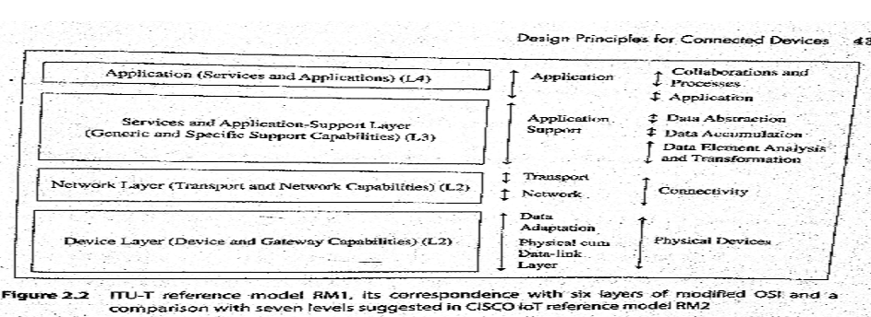

Slide 25
ITU-T recommends four layers, each with different capabilities . A comparison of ITU-T RM1 with the six-layer OSI model can be made as follows:
RM1 device layer capabilities are similar to data adaption and physical cum data-link layers.
RM1 network layer capabilities are similar to transport and network layers.
RM1 upper two layer capabilities are similar to top down layers.

Slide 26
A comparison with the CISCO IoT reference model(RM2) can be made as follows:
RM1 L4 capabilities are similar to RM2 collaborations and processes , and application top two levels.
RM1 L3 capabilities are similar to RM2 three middle-level functions of data abstraction, accumulation, analysis and transformation.
RM1 L2 layer capabilities are similar to RM2 functions at connectivity level.
RM1 L1 device layer capabilities are similar to RM2 functions at physical devices level.

Slide 27
What are the architectural layers in ITU-T reference model for Internet of RFIDs application?
Consider a model for Internet of RFIDs. Following are the capabilities of the layers and data interchange in the ITU-T reference model.
Layer1 : Device and gateway capabilities are present in the RFID physical device cum RFID reader which acquires the ID data, and communicates the enriched data according to a wireless protocol to an access point(AP).
Layer2 : Transport and network capabilities are present at access network consisting of Aps and Internet connectivity to servers.
Layer 3: Services and application-support layer capabilities at server are RFID device’s registry , ID management, RFIDs data routing to server or data centre , data analysis for the time-series device presence and device tracked positions.
Layer 4: Services and capabilities of RFIDs are tracking, inventory control of goods and business processes; for example, supply-chain management.

Slide 28
2.3 Communication technologies
Physical cum data-link layer in the model consists of a local area network/personal area network.
A local network of IoT or M2M device deploys one of the two types of technologies:
Wireless communication technologies
Wired communication technologies

Slide 29
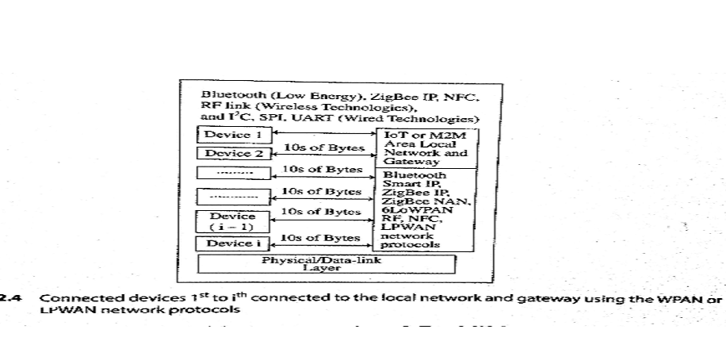
Figure 2.4 shows connected devices(1st to ith) connectivity using different technologies for communication of data from and to devices to the local network connectivity to a gateway.

Slide 30
Figure 2.4 shows number of devices present in an IoT or M2M devices network. The figure shows the local area network of devices .
The connectivity between the devices is by using RF, Bluetooth Smart Energy, ZigBee IP, ZigBee NAN, NFC or 6LowPAN or mobile.
Tens of bytes communicate at an instance between the device and local devices network.

Slide 31
2.3.1 Wireless Communication Technology
Examples of wireless communication technologies are NFC, RFID, ZigBee, BlueTooth(BT), RF transceivers and RF modules.

Slide 32
Near-Field Communication
Near-Field communication is an enhancement of ISO/IEC14443 standard for contact-less proximity-card.
NFC is a short distance wireless communication technology.
It enables data exchange between cards in proximity and other devices.
Examples of applications of NFC are proximity-card reader/RFID/IoT/M2M/mobile device, mobile payment wallet, electronic keys for car, house , office entry keys and biometric passport readers.

Slide 33
NFC devices transmit and receive data at the same instance and the setup time is 0.1s.
The device or its reader can generate RF fields for the nearby passive devices such as passive RFID.
An NFC device can check RF field and detect collision of transmitted signals.
The device can check collision when the received signal bits do not match with the transmitted signal bits.

Slide 34
Features of an NFC device are:
Range of functioning is within10 to 20 cm.
The device can also communicate with Bluetooth and Wi-Fi devices in order to extend the distance from 10cm to 30 m or higher.
The device is able to receive and pass the data to a bluetooth connection or standardised LAN or Wi-Fi using information handover functions.
Device data transfer rates are 106 kbps, 212 kbps,424 kbps and 848 kbps.

Slide 35
Three modes of communication are:
Point-to-point(P2P) mode: both devices use the active devices in which RF fields alternately generate when communicating.
Card-emulation mode: Communication without interruption for the read and write as required in a smart card and smart card reader.
FeliCa and Mifare standards are protocols for reading and writing data on the card device and reader, and then the reader can transfer information to Bluetooth or LAN.
Reader Mode : Using NFC the device reads passive RFID device. The RF field is generated by an active NFC device. This enables the passive device to communicate.

Slide 36
RFID
Radio Frequency Identification(RFID) is an automatic identification method. RFIDs use the Internet. RFID usage is, therefore , in remote storage and retrieval of data is done at the RFID tags.
An RFID device functions as tag or label, which may be placed on an object. The objects can be tracked for the movements. The object may be parcel, person, bird or an animal.
IoT applications of RFID are in business processes , such as parcels tracking and inventory control, sales log-ins and supply-chain management.

Slide 37
Bluetooth BR/EDR and Bluetooth Low energy
Bluetooth devices follow IEEE 802.15.1 standard protocol for L1. BT devices form a WPAN device network.
Two types of modes for the devices are Bluetooth BR/EDR and Bluetooth low energy.
A latest version is Bluetooth v4.2.
BT LE is also called Bluetooth Smart. BT LE range is 150m at 10mW power output , data transfer rate is 1Mbps and setup time is less than 6s.

Slide 38
Bluetooth v5 , released in June 2016, has increased the broadcast capacity by 800%, quadrupled the range and doubled the speed.
Features of BT LE or dual mode BT BR/EDR are:
Auto-synchronisation between mobile and other devices when both use BT. BT network uses features of self-discovery, self-configuration and self-healing.
Radio range depending on class of radio; class 1 or 2 or radios: 100m, 10m or 1m used in device BT implementation.
Support to NFC pairing for low latency in pairing the BT devices.
Two modes –dual or single mode devices are used for IoT /M2M devices local area network.
Ipv6 connection option for BT smart with IPSP.
Smaller packets in LE mode.
Operation in secured as well as unsecured modes.

Slide 39
ZigBee IP/ZigBee SE 2.0
ZigBee devices follow the IEEE 802.15.4 standard protocol L1. ZigBee devices form a WPAN devices network.
ZigBee end-point devices form a WPAN of embedded sensors, actuators, appliances, controllers or medical data systems which connect to the Internet for IoT applications , services and business processes.
ZigBee Neighbourhood Area Network (NAN) is a version for a smart grid. ZigBee smart energy version 2.0 has energy management and energy efficiency capabilities using an IP network.

Slide 40
Features of a ZigBee network are:
L1 layer PDU=127B
Used for low-power, short-range WPAN
The device can function in six modes- end point, ZigBee-ZigBee devices router, ZigBee network coordinator, ZigBee-IP coordinator, ZigBee-IP router and IP host.
ZigBee IP enhancement provisions the IPv6 connectivity. A zigBee IP device is a Reduced Function Device(RFD).
The ZigBee router uses reactive and proactive protocols for routing mode, which enable applications in big-scale automation and remote controls.
A self-configuring and self-healing dynamic pairing mesh network, supports both multicast and unicast options.
Support to development of discovery mechanism with full application confirmation.

Slide 41
ZigBee NAN is for devices which are used for smart-metering, distribution automation devices and smart grid communication profile.
NAN enables utility’s last-mile at HAN , outdoor access network that connects smart meters to WAN gateways.

Slide 42
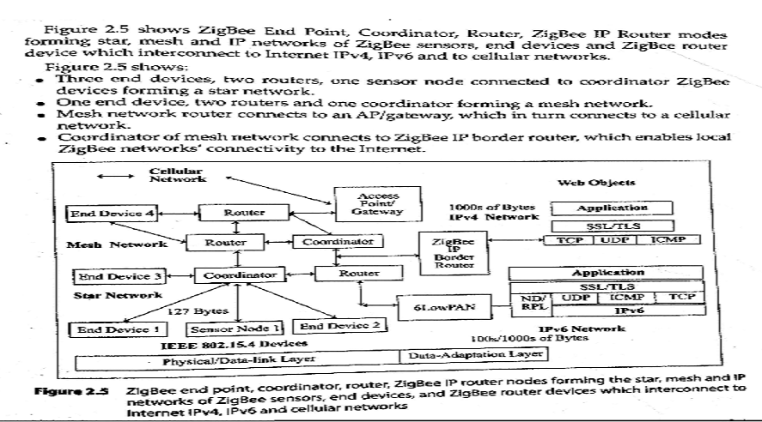

Slide 43
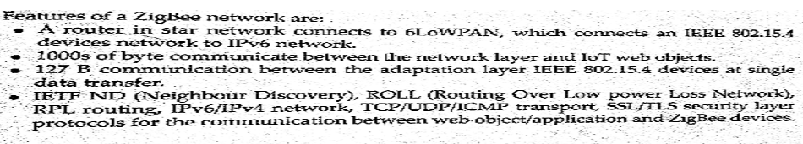

Slide 44
Wi-Fi
Wi-Fi is an interface technology that uses IEEE 802.11 protocol and enables the Wireless Local Area Networks .
Wi-Fi devices connect enterprises, universities and offices through home AP/public hotspots.
Wi-Fi connects distributed WLAN networks using the Internet.

Slide 45
Automobiles, instruments, home networking, sensors, actuators , industrial device nodes, computers, tablets, mobiles, printers and many devices have Wi-Fi interface.
Wi-Fi is very popular. The issues of Wi-Fi interfaces, APs and routers are higher power consumption, interference and performance degradation.

Slide 46
Wi-Fi interfaces connect within themselves or to an AP or wireless router using Wi-Fi PCMCIA or PCI card or built-in circuits cards and through the following:
Base station (BS) or AP
A WLAN transceiver or BS can connect one or many wireless devices simultaneously to the Internet.
Peer-to-Peer nodes without access point: client devices within Independent Basic Service Set(IBSS) network can communicate directly with each other. It enables fast and easy setting of an 802.11 network.
Peer to multipoint nodes with Basic Service Sets using one in-between AP point or distributed BSSs connect through multiple Aps.
Connectivity range of each BSS depends on the range of wireless bridges and antennae used and environmental conditions.
Each BSS is a service Set Identifier(SSID).

Slide 47
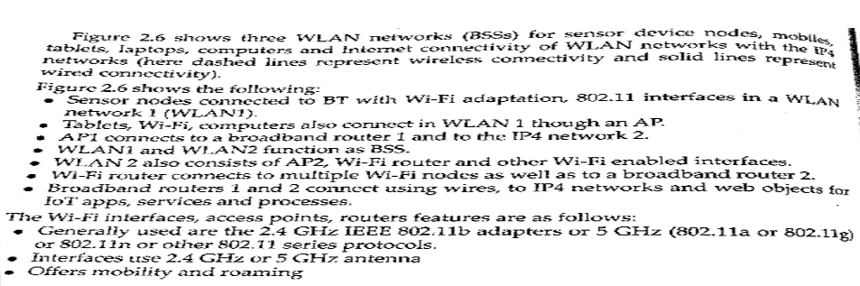

Slide 48
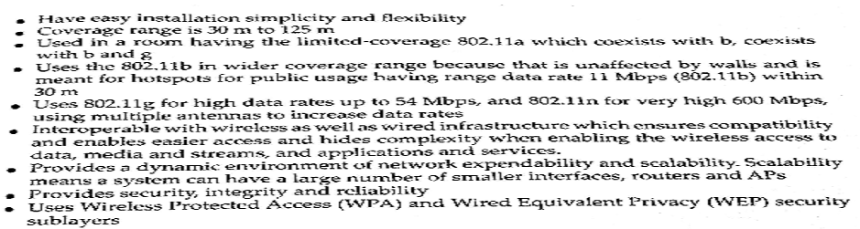

Slide 49
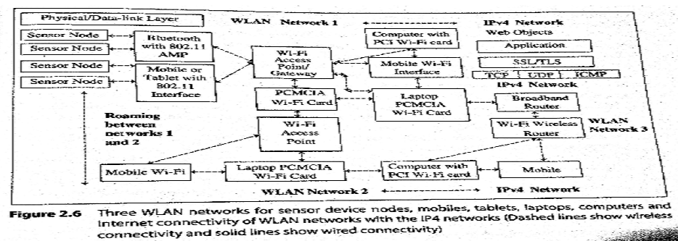

Slide 50
RF transceivers and RF Modules
RF transmitters, receivers, and transceivers are the simplest RF circuits.
A transceiver transmits the RF from one end and receives the RF from one end and receives the RF from the other end, but internally has an additional circuit, which separates the signals from both ends.
An oscillator generates RF pulses of required active duty cycle and connects to a transmitter.
BT, ZigBee and Wi-Fi radios deploy ISM band transceivers which have comparatively complex circuits.

Slide 51
A number of systems use RF modules for applications needing wireless connectivity; for example, security , telemetry, telematics, fleet management, back-up cameras and GPS navigation service, payment wallet, RFID and maintenance.

Slide 52
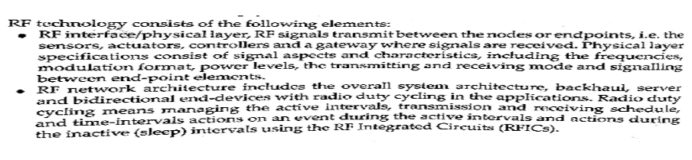

Slide 53
GPRS/GSM Cellular Networks-Mobile Internet
An IoT/M2M communication gateway can access a Wireless Wide Area Network(WWAN).
The network access may use a GPRS cellular network or new generation cellular network for Internet access.
A mobile phone provisions for a USB wired port, BT and Wi-Fi connectivity.
Wireless connectivity for Internet uses data connectivity using GSM, GPRS, UMTS/LTE and WiMax services of a mobile service provider or Wi-Fi using a modem.
A phone, generally, provisions for number of sensors also ; for example, acceleration, GPS and proximity.

Slide 54
Wireless USB
Wireless USB is a wireless extension of USB 2.0 and it operates at ultra-wide band(UWB) 5.1GHz to 10.6GHz frequencies.
It is for short-range personal area network.
FCC recommends a host wire adapter(HWA) and a device wire adapter(DWA), which provides wireless USB solution.
Wireless USB also supports dual-role devices(DRDs).
A device can be a USB device as well as limited capability host.

Slide 55
2.3.2 Wired Communication Technology
Wired communication can be serial asynchronous or synchronous serial communication.
Communications can be over a bus when a number of systems connect through a common set of interconnections.
Bus refers to a number of systems connected through a common set of control, address and data signals such that the data signals are accepted by the device at destination address only from a source at an instance.
But signals may be sent in a serial or parallel manner.
Communication is between a master at a given instance and the destined address computer at an instance.
Wired communication can be done using Ethernet IEEE 802.2 bus specifications.

Slide 56
UART/USART Serial Communication
A universal Asynchronous Transmitter(UART) enables serial communication of 8 bits serially with a start bit at the start of transmission of a byte on serial Transmitter Data output line.
Serial means present one after another at successive time intervals.
Asynchronous refers to all bytes in a frame transmit, which can result in variation in time interval spacing or phase differences between successive bytes and in-between wait interval.
This is because clock information of transmitter does not transmit along with the data.
The receiver clock also does not synchronise with the data. Further, successive set of bytes may wait after transmission till an acknowledgement is received from the receiving end.

Slide 57
The intervals of each transmit bit are controlled by a clock. When the clock period is T=0.01µs, then period for transmission of a byte on T×D=10T=0.1µs.
A byte’s transfer rate is 1 MBps. Reciprocal of T in UART is called Baud rate.
When an additional bit appends between stop bit and last bit of the byte, then T=0.11µs.
An additional bit can be used to identify the received byte on the serial line as the address or data.
It can be used for error detection.

Slide 58
An Universal Synchronous Asynchronous Transmitter (USART) enables serial communication in synchronous as well as asynchronous modes.
Synchronous means all bytes in a frame transmit with equal time spacing or equal phase differences.

Slide 59
Serial Peripheral Interface
Serial Peripheral Interface(SPI) is one of the widely used serial synchronous communication methods.
Source of serial synchronous output or input is called master when it also controls the synchronising clock information to the receiver.
A receiver of serial synchronous input or output is called a slave, when along with the serial data is also receives the synchronising clock information from the master.
Four sets of signals, viz., SCLK, MISO, MOSI, and SS are used on four wires. When SS is active, then the device functions as a slave.

Slide 60
Master Input Slave Output(MISCO) and Master Output Slave Input (MOSI) are synchronous serial bits I/Os at the master slave and IOs are as per synchronising clock of the master SCLK.
MOSI is output from master and input at slave and SCLK ( Clock information or signal) is from the master to slave.
Slave synchronises and receives the inputs bits as MOSI from the master as per the SCLK input at slave.
MISO is synchronous serial input at the master for the serial output from slave. Slave synchronises output as per SCLK of the master. Master synchronises the input as per SCLK of the master.

Slide 61
I2C Bus
A number of device integrated circuits for sensors, actuators, flash memory and touchscreens need data exchanges in a number of processes.
ICs mutually network through a common synchronous serial bus, called inter-integrated circuit.
Four potential modes of operation for I2C bus device and generally most devices have a single role and use two modes only.

Slide 62
The I2C was originally developed at Philips Semiconductors. There are three I2C bus standards: Industrial 100kbps I2C, 100kbps SM I2C and 400 kbps I2C.
I2C bus has two lines that carry the signals – one line is for the clock and one is for bidirectional data.
I2C bus protocol has specific fields. Each fields has a specific number of bits, sequence and time intervals between them.

Slide 63
Wired USB
Universal Serial Bus(USB) is for fast serial transmission and reception between the hosts, the embedded system and distributed serial devices;
For example, like connecting a keyboard, printer or scanner.
USB is a bus between the host system and a number of interconnected peripheral devices.
Maximum 127 devices can connect with a host.
USB standard provides a fast as well as a low –speed serial transmission and reception between the host and serial devices. Both the host and device can function in a system.

Slide 64
USB three standards are USB 1.1, 2.0 480 Mbps, 3.0 5 Gbps and 3.1.
Features of a USB are:
USB data format and transfer serial signals are Non Return to Zero (ZRZI) and the clock is encoded by inserting synchronous code (SYNC) field before each packet.
The receiver synchronises bit recovery clock continuously. The data transfer is of four types- controlled data transfer, bulk data transfer, interrupt driven data transfer and isosynchronous transfer.

Slide 65
USB is a polled bus.
Polling mode functions as :
A host controller regularly polls the presence of a device as scheduled by the software.
It sends a token packet. The token consists of fields for type, direction, USB device address and device end-point number.
A USB supports three types of pipes
Stream with no USB-defined protocol is used when the connection is already established and the data flow starts.
Default control is for providing access.
Message is for control functions of the device. The host configures each pipe with the data bandwidth to be used, transfer service type and buffer sizes.

Slide 66
Ethernet
Ethernet standard is IEEE802.2 protocol for protocol for local area network of computers, workstations and device LANs.
Each frame at a LAN consists of header.
Ethernet enables the services of local device nodes, computers, systems and local resources, such as printers, hard disk space, software and data.

Slide 67
Features of Ethernet network are:
Uses passive broadcast medium and is wired connections based.
Formatting of frame is according to IEEE 802.2 standard.
Uses a 48 bit MAC address assigned distinctly to each computer on the LAN.
Address Resolution Protocol(ARP) resolves a 32 bit IP address at Internet device LANs. Each frame at a LAN destination host media address. Reverse address Resolution Protocol (RARP) resolves 48bit destination host media address into 32 bit IP addresses for Internet communication.
Uses wired bus topology ,and transmission speeds are 10 Mbps, 100Mbps, 1 Gbps, 4 Gbps and 10 Gbps.

